Slide 1
AI agent for Web search
A Local LLM-Powered Web Analysis Tool
By jeyaram

Slide 2
Abstract: AI Agent Development with Ollama and Llama 3.2
This AI agent represents a significant advancement in automated web content analysis, offering organizations the ability to efficiently process and analyze web content while maintaining control over their data through local deployment. The system's modular design allows for easy updates and improvements as newer models become available.

Slide 3
Implementation of WebSearchAgent
Step 1: Model Setup & Configuration
Local LLM Implementation
Deployed Llama 3.2 3 Billion model locally using Ollama framework
Created custom Web Search Agent model with specialized system prompts
Implemented dedicated instruction set for web content analysis
Optimized for local processing and response generation

Slide 4
Step 2: Tool Function Integration
Data Processing Pipeline
Developed URL detection and validation system
Implemented web scraping functionality to extract content
Created data injection pipeline to enhance system prompt
Engineered feedback loop for content analysis and processing
Built seamless integration between model and scraped data

Slide 5
Step 3: Query Processing System
Versatile Content Analysis
Enabled comprehensive webpage analysis capabilities
Implemented flexible query handling for:
Content summarization
Question answering
Information extraction
Designed for natural conversation flow with context retention
Optimized for accurate and relevant response generation

Slide 6
Practical Applications
Real-time webpage analysis
Automated content summarization
Interactive Q&A about web content
Document analysis and extraction
Custom query processing

Slide 7

Demos

Slide 8
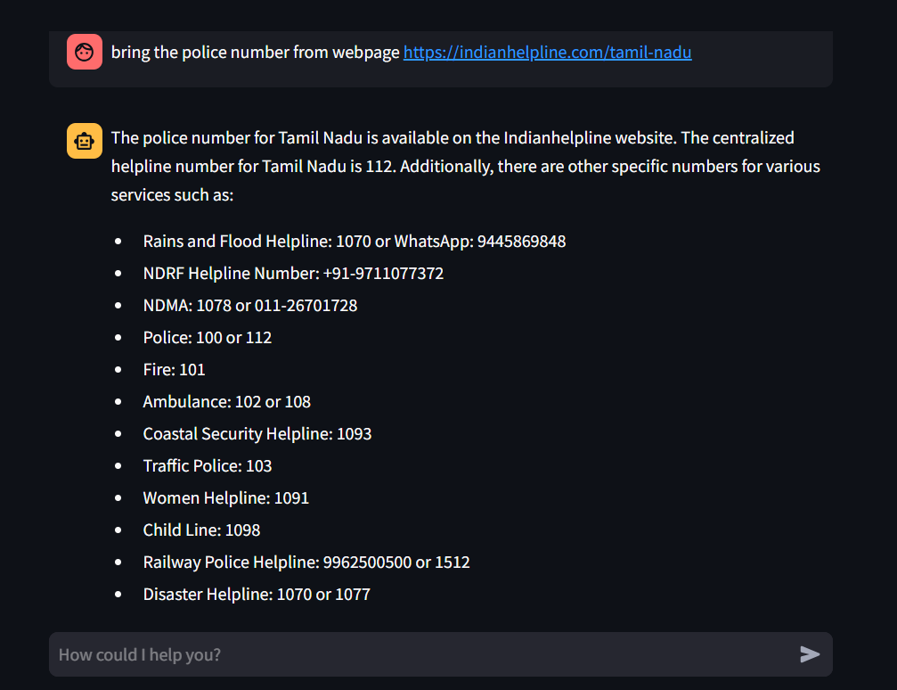
Demos

Slide 9
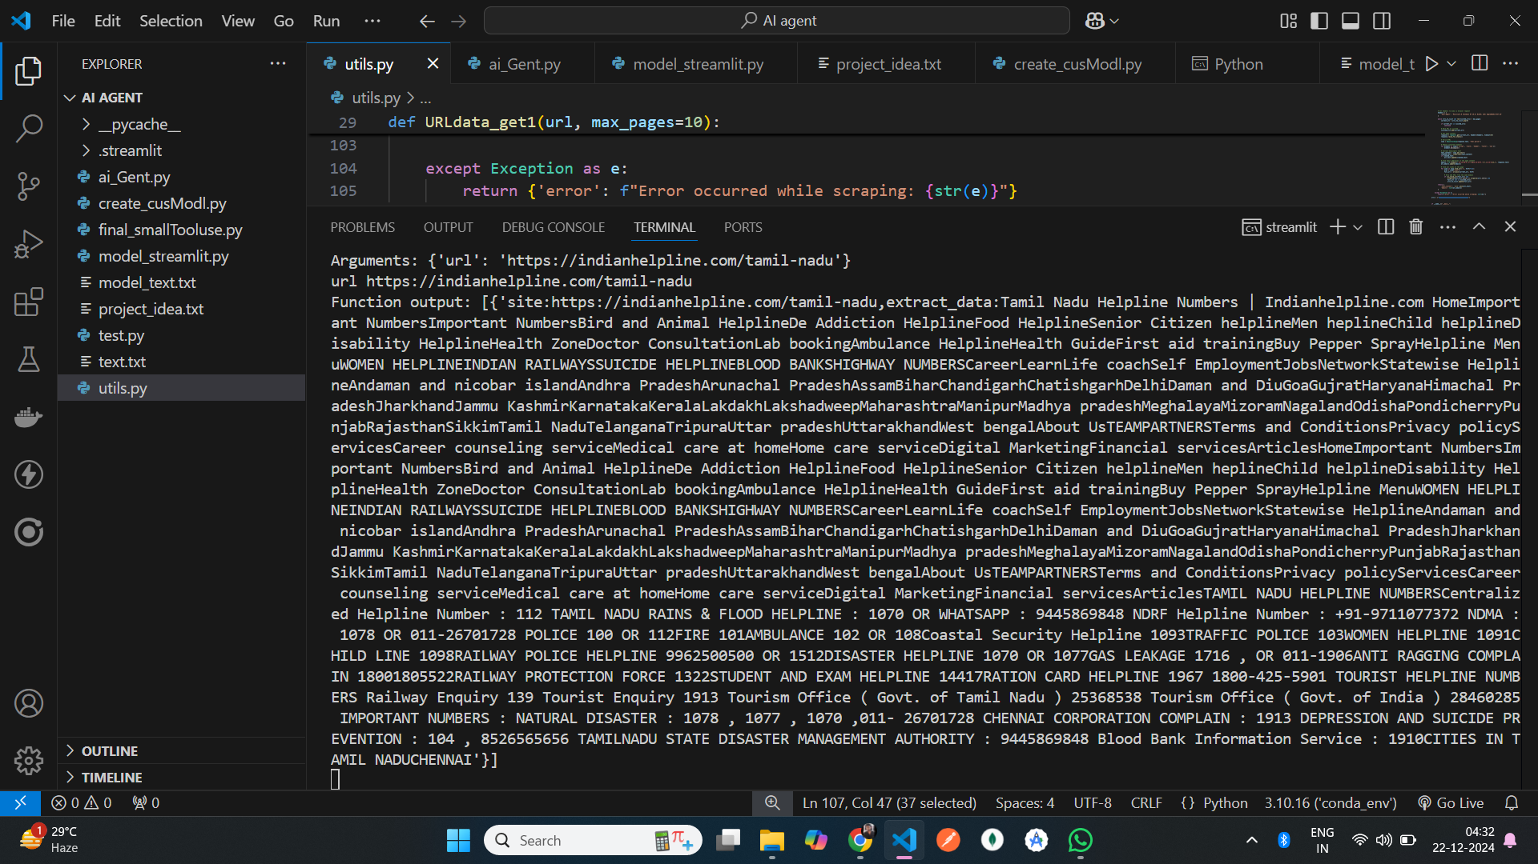
Demos
Data that was scrapped by tool it then inject to the model to some knowledge

Slide 10
THANK YOU
Jeyaram k

